Slide 1


Implementing Machine Learning Techniques in Enhancing Epidemic Modeling: A COVID-19 Case Study in Africa
Research Proposal
Name: Alex Mutebe
Course: MSc Data Science
Module: Research Methods and Professional Practice

Slide 2
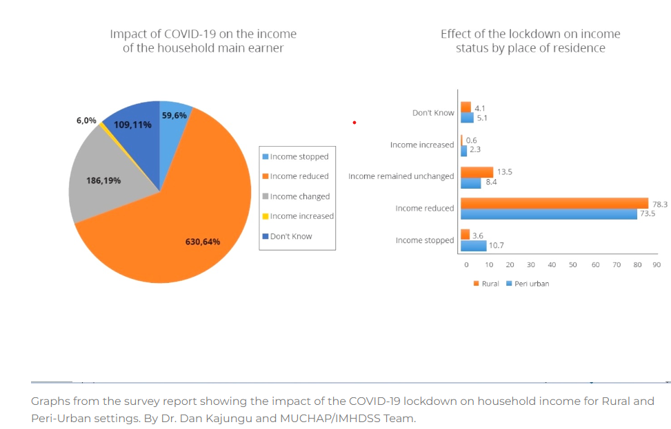
Significance and Contribution
The COVID-19 pandemic has presented a global challenge (Lone & Ahmad,2020; Ciotti et al.,2020)
Address limitations in traditional epidemic modeling methods(Franco, 2020, Wang et al.,2020).
Improve prediction (Alfred & Obit,2021).
Contribute to the discipline by providing more accurate, real-time predictions of epidemic spread
Support informed decisions in public health (Arnett & Claas, 2017).

Slide 3
Research Question
The central research question is: “How can machine learning improve the accuracy and predictive power of epidemic models?”
This question will guide the exploration of ML algorithms’ effectiveness in modeling and predicting disease outbreaks (Salim et al.,2021).

Slide 4
Aims and Objectives
To develop a robust ML framework that enhances the predictive capabilities of epidemic models.
To validate the ML models using historical data and compare their performance against traditional models.
To create a user-friendly tool that can be used by public health officials for epidemic forecasting.

Slide 5
Key Literature
“The roles of machine learning methods in limiting the spread of deadly diseases: A systematic review”. This paper surveys various ML techniques used in outbreak prediction.
“Predicting Epidemics Using Machine Learning: Challenges and Opportunities” – This article discusses the potential and limitations of using ML in epidemic modeling.

Slide 6
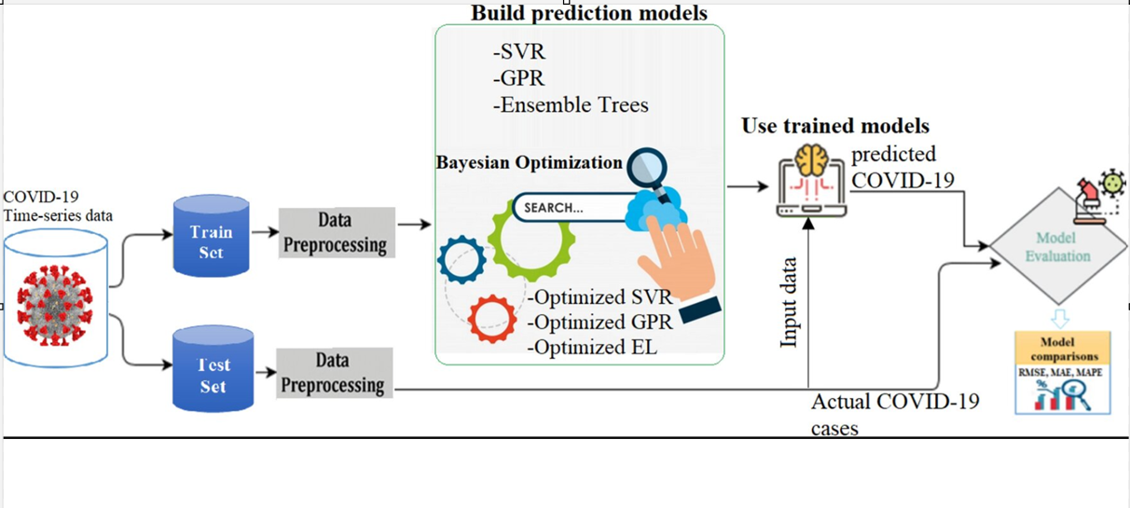
Methodology
Data collection
Model development
Model training on historical data
Model validation and testing
(Solanki & Singh, 2021)
Credit: Scientific Reports (2022)

Slide 7
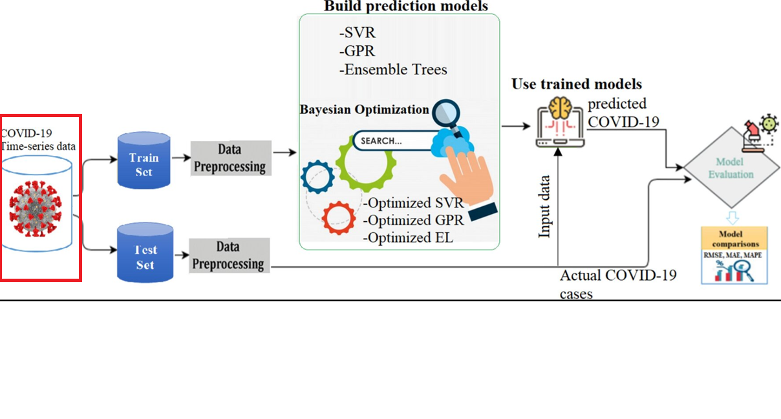
Methodology cont.
Data collection
Model development
Model training on historical data
Model validation and testing
(Bojer & Meldgaard,2021)
Credit: Scientific Reports (2022)

Slide 8
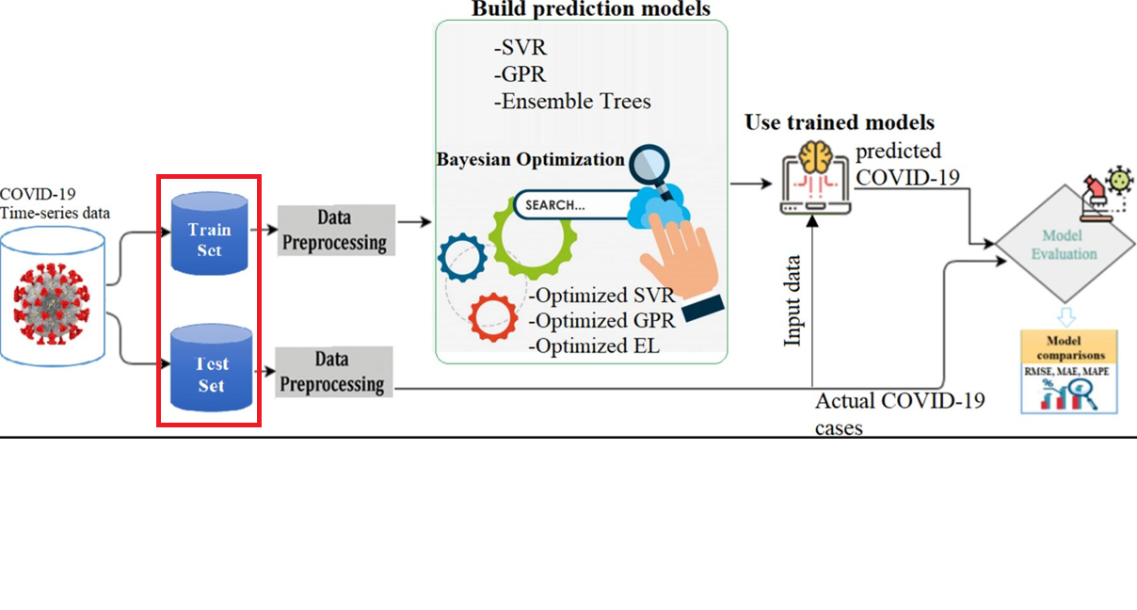
Methodology cont.
Data collection
Model development
Data Preprocessing
Model training on historical data
Model validation and testing
(Medar et al.,2017)
Credit: Scientific Reports (2022)

Slide 9
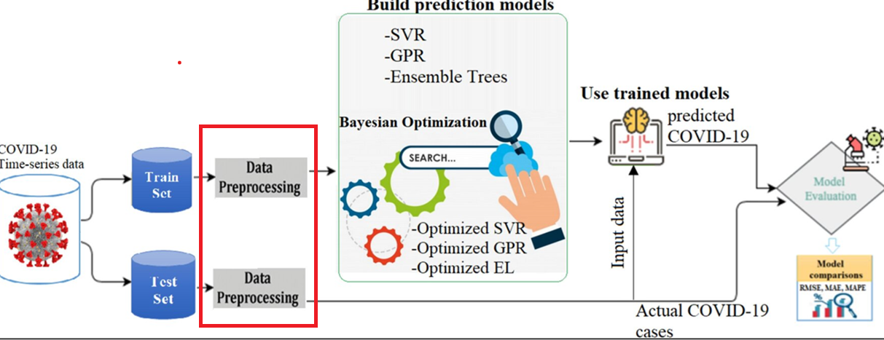
Methodology cont.
Data collection
Model development
Data Preprocessing
Model training on historical data
Model validation and testing
(García et al.,2016)
Credit: Scientific Reports (2022)

Slide 10
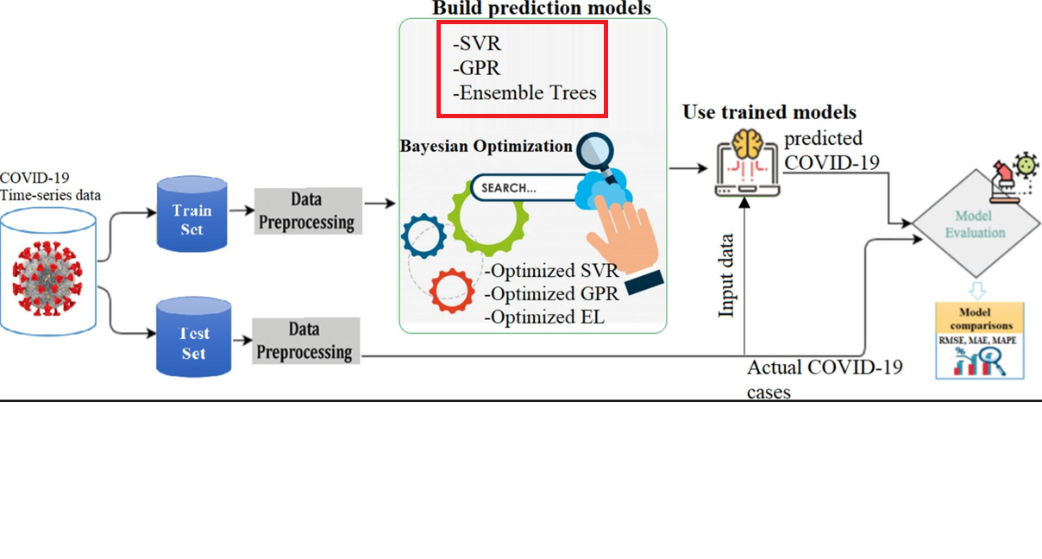
Methodology cont.
Data collection
Model development
Data Preprocessing
Model training on historical data
Model validation and testing
(Solanki & Singh, 2021)
Credit: Scientific Reports (2022)

Slide 11
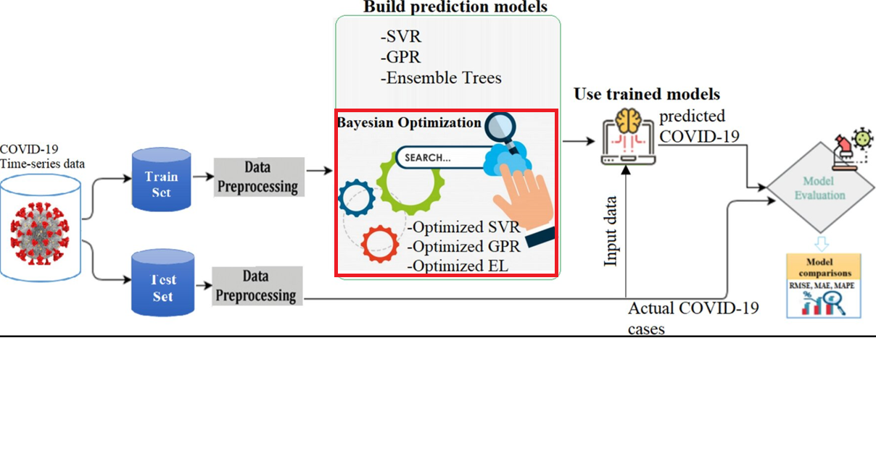
Methodology cont.
Data collection
Model development
Data Preprocessing
Model training on historical data
Model validation and testing
(Wu et al.,2019; Barbiero et al.,2020)
Credit: Scientific Reports (2022)

Slide 12
Ethical Considerations and Risk Assessment
Ethical considerations include ensuring data privacy and security, obtaining necessary approvals for data use, and addressing potential biases in ML models(Char et al.,2020).
Risk assessment will cover the accuracy of predictions, potential misuse of predictive tools, and ensuring transparency in model development(Erickson, 2021).

Slide 13
Artefact
Software application that incorporates ML models for epidemic prediction (Bhatt et al.,2020)

Slide 14
Challenges
Data Quality and Availability
Model Complexity
Overfitting/Underfitting
Bias and Fairness
Ethical Considerations
Regulatory Compliance
Scalability
Integration
Monitoring and Maintenance

Slide 15

Timeline of Activities
Literature review & Data collection: 8 Weeks
Model development Testing: 8 Weeks
Model validation: 8 Weeks
User interface: 5 Weeks

Slide 16
Conclusion
Our research addresses a critical need for accurate epidemic modeling
Our study bridges the gap between traditional epidemiological models and modern data-driven approaches
Ethical approval for data collection
Collaborate with public health authorities for real-world impact

Slide 17
Thank you ☺

Slide 18
References:
Alfred, R. and Obit, J.H., 2021. The roles of machine learning methods in limiting the spread of deadly diseases: A systematic review. Heliyon, 7(6).
Arnett, D.K. and Claas, S.A., 2017. Introduction to epidemiology. In Clinical and Translational Science (pp. 53-69). Academic Press.
Barbiero, P., Squillero, G. and Tonda, A., 2020. Modeling generalization in machine learning: A methodological and computational study. arXiv preprint arXiv:2006.15680.
Bhatt, U., Xiang, A., Sharma, S., Weller, A., Taly, A., Jia, Y., Ghosh, J., Puri, R., Moura, J.M. and Eckersley, P., 2020, January. Explainable machine learning in deployment. In Proceedings of the 2020 conference on fairness, accountability, and transparency (pp. 648-657).

Slide 19
Bojer, C.S. and Meldgaard, J.P., 2021. Kaggle forecasting competitions: An overlooked learning opportunity. International Journal of Forecasting, 37(2), pp.587-603.
Char, D.S., Abràmoff, M.D. and Feudtner, C., 2020. Identifying ethical considerations for machine learning healthcare applications. The American Journal of Bioethics, 20(11), pp.7-17.
Ciotti, M., Ciccozzi, M., Terrinoni, A., Jiang, W.C., Wang, C.B. and Bernardini, S., 2020. The COVID-19 pandemic. Critical reviews in clinical laboratory sciences, 57(6), pp.365-388.
Dogan, O., Tiwari, S., Jabbar, M.A. and Guggari, S., 2021. A systematic review on AI/ML approaches against COVID-19 outbreak. Complex & Intelligent Systems, 7, pp.2655-2678.
Erickson, B.J. and Kitamura, F., 2021. Magician’s corner: 9. Performance metrics for machine learning models. Radiology: Artificial Intelligence, 3(3), p.e200126.

Slide 20
Franco, E., 2020. A feedback SIR (fSIR) model highlights advantages and limitations of infection-dependent mitigation strategies. arXiv preprint arXiv:2004.13216.
García, S., Ramírez-Gallego, S., Luengo, J., Benítez, J.M. and Herrera, F., 2016. Big data preprocessing: methods and prospects. Big data analytics, 1, pp.1-22.
Larracy, R., Phinyomark, A. and Scheme, E., 2021, November. Machine learning model validation for early stage studies with small sample sizes. In 2021 43rd Annual International Conference of the IEEE Engineering in Medicine & Biology Society (EMBC) (pp. 2314-2319). IEEE.
Lone, S.A. and Ahmad, A., 2020. COVID-19 pandemic–an African perspective. Emerging microbes & infections, 9(1), pp.1300-1308.

Slide 21
Medar, R., Rajpurohit, V.S. and Rashmi, B., 2017, August. Impact of training and testing data splits on accuracy of time series forecasting in machine learning. In 2017 International Conference on Computing, Communication, Control and Automation (ICCUBEA) (pp. 1-6). IEEE.
Michelson, K.N., Klugman, C.M., Kho, A.N. and Gerke, S., 2022. Ethical considerations related to using machine learning-based prediction of mortality in the pediatric intensive care unit. The Journal of pediatrics, 247, pp.125-128.
Murshed, M.S., Murphy, C., Hou, D., Khan, N., Ananthanarayanan, G. and Hussain, F., 2021. Machine learning at the network edge: A survey. ACM Computing Surveys (CSUR), 54(8), pp.1-37.
Paleyes, A., Urma, R.G. and Lawrence, N.D., 2022. Challenges in deploying machine learning: a survey of case studies. ACM computing surveys, 55(6), pp.1-29.

Slide 22
Rosenkrantz, D.J., Vullikanti, A., Ravi, S.S., Stearns, R.E., Levin, S., Poor, H.V. and Marathe, M.V., 2022. Fundamental limitations on efficiently forecasting certain epidemic measures in network models. Proceedings of the National Academy of Sciences, 119(4), p.e2109228119.
Salim, N.A.M., Wah, Y.B., Reeves, C., Smith, M., Yaacob, W.F.W., Mudin, R.N., Dapari, R., Sapri, N.N.F.F. and Haque, U., 2021. Prediction of dengue outbreak in Selangor Malaysia using machine learning techniques. Scientific reports, 11(1), p.939.
Solanki, A. and Singh, T., 2021. COVID-19 epidemic analysis and prediction using machine learning algorithms. Emerging technologies for battling Covid-19: applications and innovations, pp.57-78.
Wang, P., Zheng, X., Li, J. and Zhu, B., 2020. Prediction of epidemic trends in COVID-19 with logistic model and machine learning technics. Chaos, Solitons & Fractals, 139, p.110058.

Slide 23
Wu, J., Chen, X.Y., Zhang, H., Xiong, L.D., Lei, H. and Deng, S.H., 2019. Hyperparameter optimization for machine learning models based on Bayesian optimization. Journal of Electronic Science and Technology, 17(1), pp.26-40.
Zhou, J., Gandomi, A.H., Chen, F. and Holzinger, A., 2021. Evaluating the quality of machine learning explanations: A survey on methods and metrics. Electronics, 10(5), p.593.

